Slide 1

ThinkItThru
By Jensen Schmidt, Zachary Travis, and Levi Wright

Slide 2

Discussion Outline
Introduction
Block Diagram Information
Message and Storage (Server Setup)
Client Interaction
Storyboard

Slide 3

Introduction
ThinkItThru! motivates users to organize their day and satisfy academic deadlines
Users may accomplish this by:
Creating tasks for themselves
Which will be scheduled into goals
Enjoy their rewards for accomplishing their goals!

Slide 4
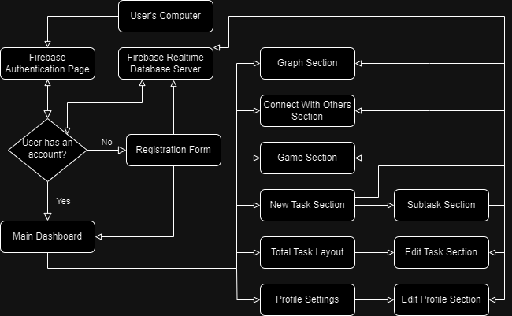
Block Diagram Information

Slide 5
Block Diagram Information
Key take-aways:
Using Firebase for federated Authentication
Using Firebase Realtime Database
Various reasons to push/pull data
Login
Editing info
Creating info

Slide 6
Server Setup
Firebase Realtime Database:
Set up as a large JSON tree
JSON incorporates a lot of data objects in nodes
User, Gameboard,
Can create arrays of data
Can update quite a bit
Drawback of pulling all the child nodes of the tree
Not much of an issue currently
Separated design to make individual pieces

Slide 7
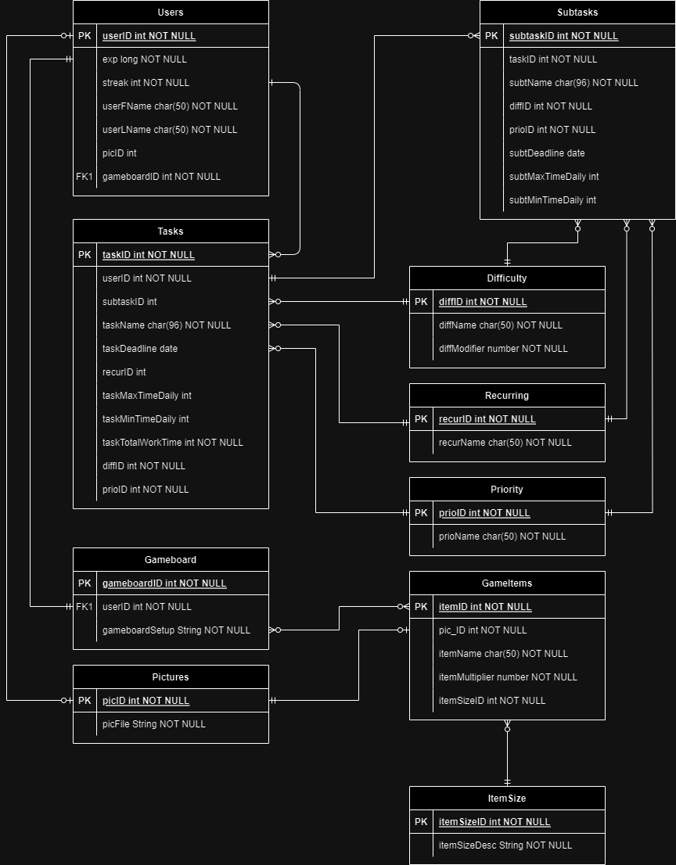
Server Setup
Users
Tasks
Subtasks
Gameboard
(To prevent too much data from being pulled at once, we utilize several data objects that are called to, such as difficulty, priority, pictures, game items, etc.)

Slide 8
Client Interaction
The client interacts with login
Firebase Auth
Account data? If not, registration
Registration communicates new objects to database
Login page communicates data to database (update streak/exp)
Edit information pages overwrite data
New tasks pages updates data
Game updates data in Gameboard

Slide 9
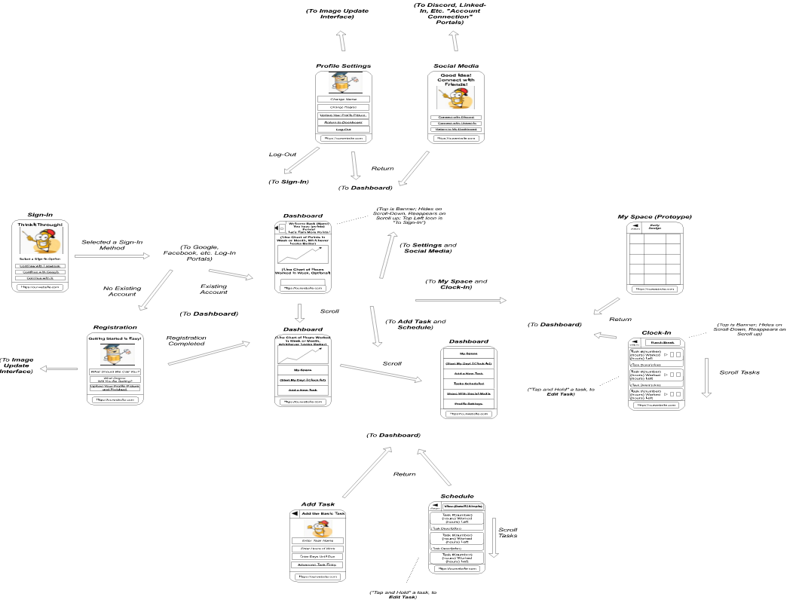
Storyboard

Slide 10
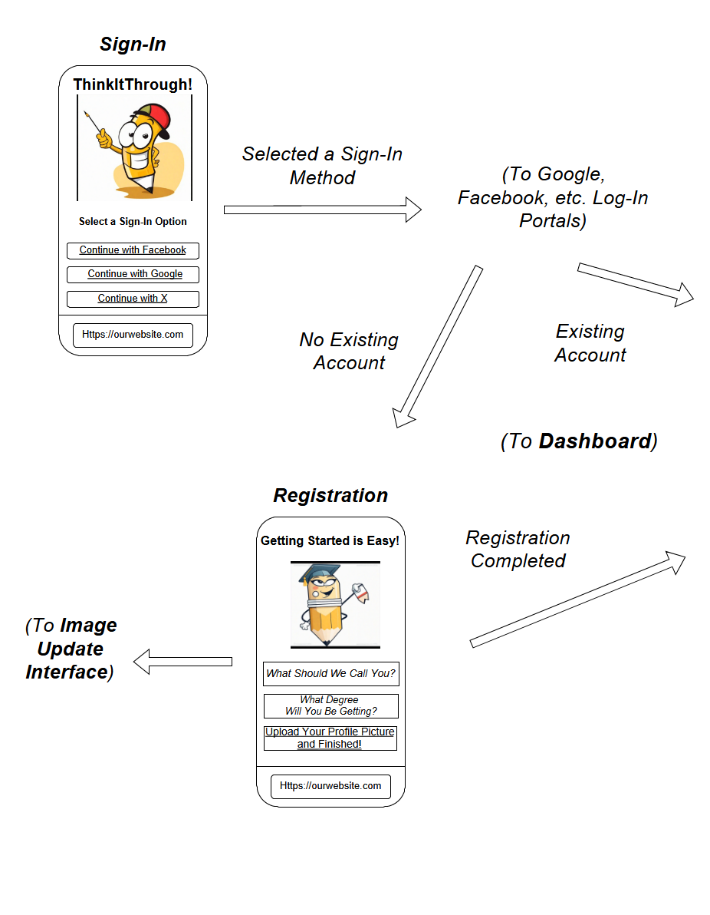
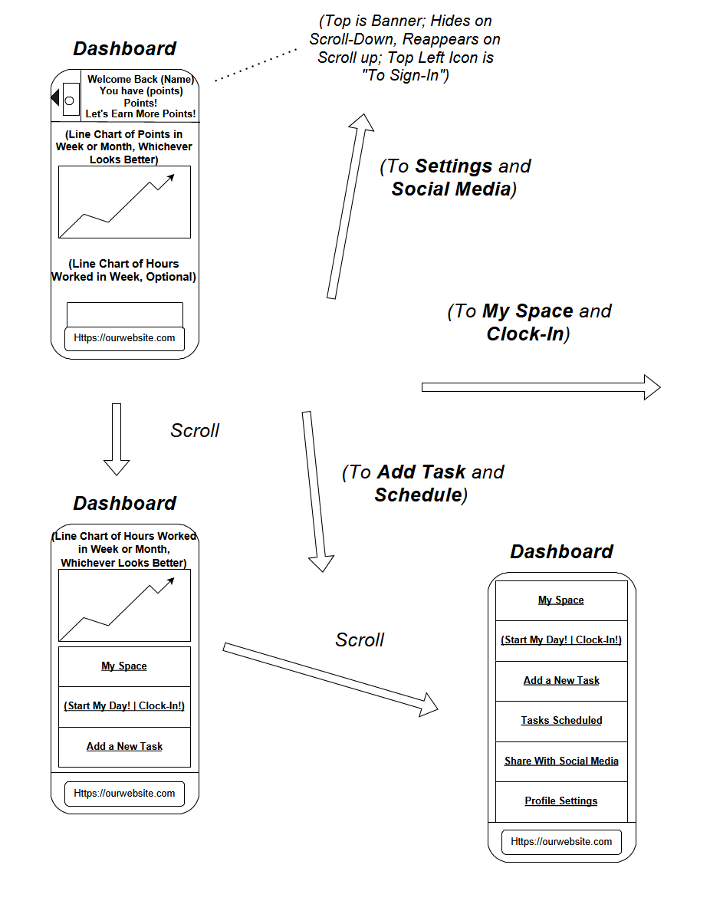

Slide 11
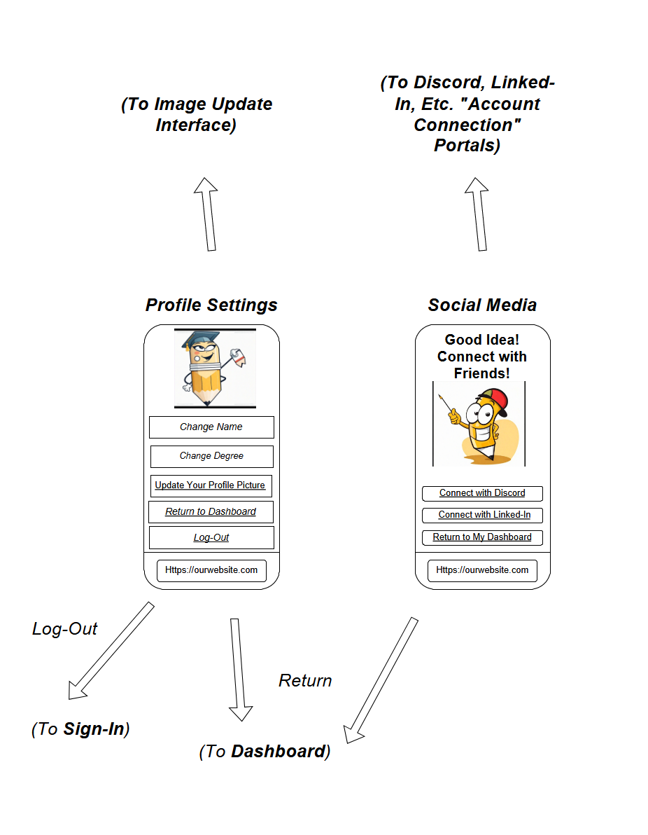
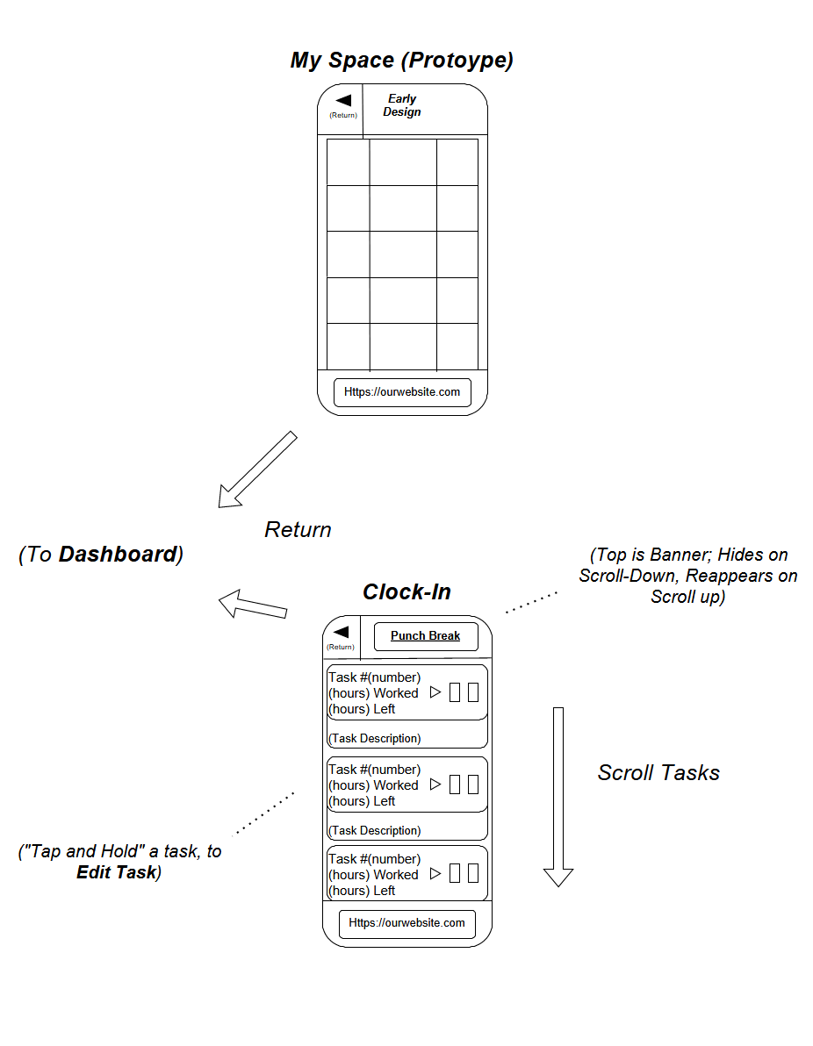
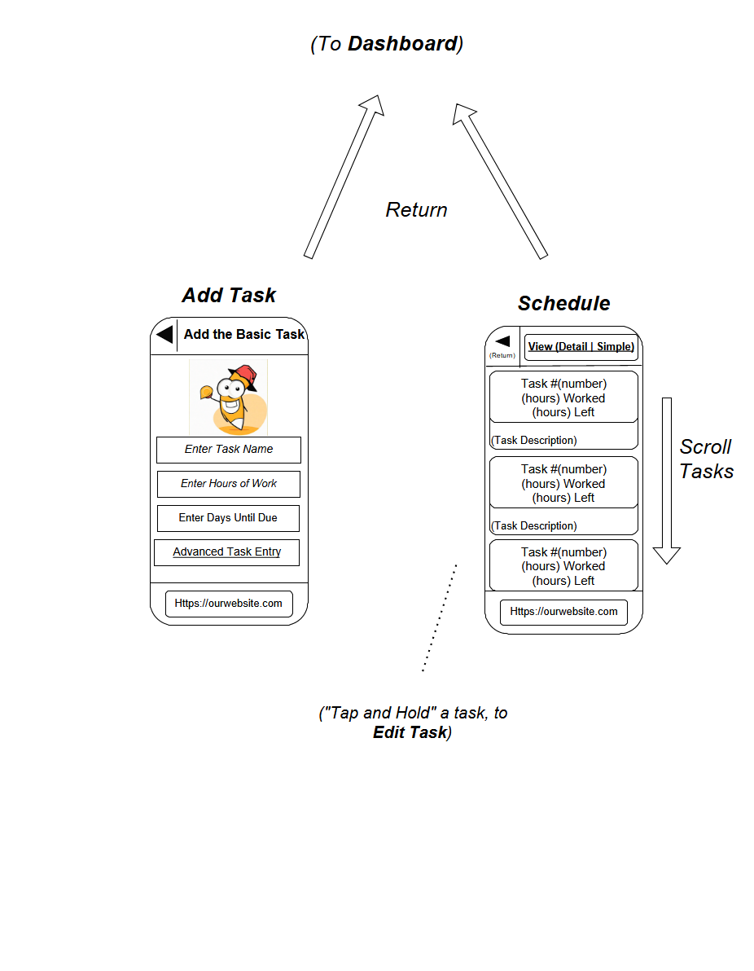
Storyboard Cont.

